Slide 1
HR Management
HR Functions
Cdr Vijay Pratap Singh, Adjunct Professor

Slide 2
HRM-Functions
Talent Acquisition: concerned with procuring and employing people who possess necessary skills.
Job Analysis: Collecting information relating to operations and responsibilities of a specific job.
Human Resources Planning: process of determining and assuring that the organisation will have an adequate number of qualified person.
Recruitment & Selection: Searching for prospective employees and process of ascertaining suitability.

Slide 3
HRM-Functions
Job Distribution: It ensures a 360 degree fit, matching the employee’s qualifications with the job on offer.
Induction and orientation Training: a new employee is rehabilitated in his new surroundings.
Internal Mobility: movement of employees from one job to another through transfers and promotions.ve

Slide 4
HRM-Functions
Motivation and Compensation: inspires people to give their best.
Job design: Organizing tasks and responsibilities towards having a productive unit of work.
Work scheduling: Organisation must realize the importance of scheduling work to motivate employees. eg. Flexi-time etc.
Motivation: Increase their inner urge to perform
Job evaluation: Determining worth of the job
Performance appraisal: evaluating employees performance.
Compensation, Incentives and benefits

Slide 5
HRM-Functions
Integration Functions
Grievance redressal: Complaint against the employer
Discipline: follow rules and regulations
Teams and Teamwork: Enhance employee involvement and have the potential to create positive energy.
Collective bargaining
Employee participation and empowerment
Trade unions and employer’s associations
Industrial relations

Slide 6
HRM-Functions
Maintenance Function: Protecting and preserving the physical and psychological health of employees.
Health and safety: Standards have to be maintained. Protect employees from physical hazards.
Employee welfare: Benefits like, sickness, Disablement, Retirement etc.

Slide 7
HRM-Functions
Training & Development: Employees learn skills, knowledge, abilities and attitudes. Improving, changing and developing skills are provided on progressive basis as and when required.
e.g. Executive development: process of developing managerial skills and capabilities.

Slide 8
HRM-Functions
Career planning and development: planning of one’s career and implementation of career plans by means of education etc.
Human resource development: HRD creates a climate that enables every employee to develop and use his capabilities to optimize his/her performance.

Slide 9
HRM-Functions
Emerging Issues
Personnel Records
Human Resource Audit
Human Resources Research
Human Resources Accounting
Human Resource Information System(HRIS)
Stress & Counseling
International Human Resource Management
Other Issues: Empowerment, Workforce Diversity, Downsizing.

Slide 10
Summary of HRM Functions
Societal
Legal Compliance
Benefits
Union management relationship
Organisational
Human Resource Planning
Employee Relations
Selection
Training & Development
Appraisal
Placement in correct job
Assessment

Slide 11
Summary of HRM Functions
Functional
Appraisal
Placement
Assessment
Personal
Training & Development
Placement
Assessment
Compensation

Slide 12
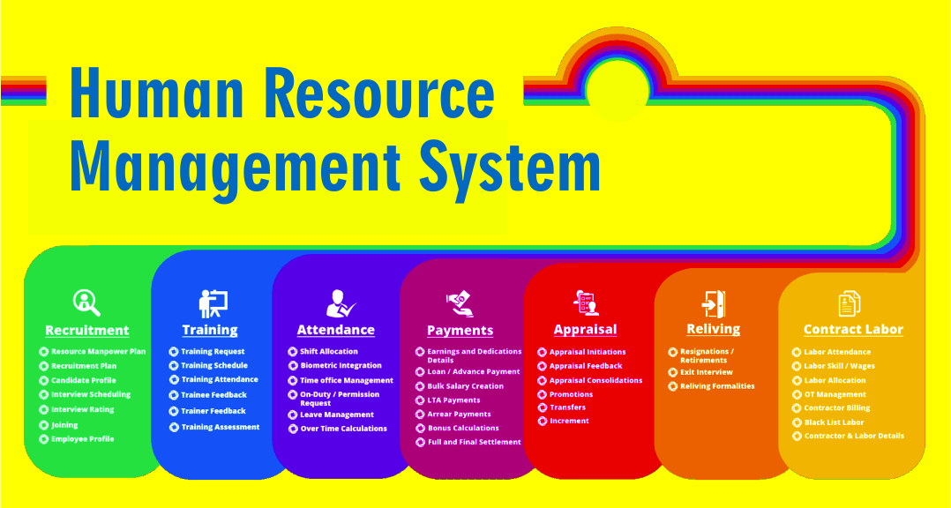

Slide 13
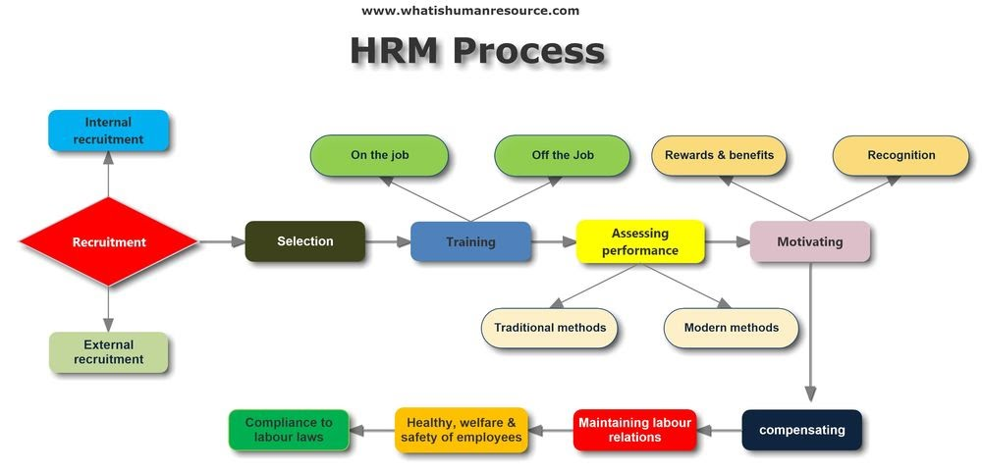
HRM Process flow Diagram

Slide 14
Q & A Session

